Slide 1
Computer Architecture 1
Computer Organization and Design T H E H A R D W A R E / S O F T W A R E I N T E R F A C E
[Adapted from Computer Organization and Design, RISC-V Edition, Patterson & Hennessy, © 2018, MK] [Adapted from Great ideas in Computer Architecture (CS 61C) lecture slides, Garcia and Nikolíc, © 2020, UC Berkeley]

Slide 2
Instructions: Language of the Computer
Introductions
Operations of the Computer Hardware
Operands of the Computer Hardware
Logical Operations
Instructions for Making Decisions

Slide 3
Introduction
To demonstrate how easy it is to pick up other instruction sets, we will also take a quick look at two other popular instruction sets.
MIPS is an elegant example of the instruction sets designed since the 1980s. In several respects, RISC-V follows a similar design.
The Intel x86 originated in the 1970s, but still today powers both the PC and the Cloud of the post-PC era.

Slide 4
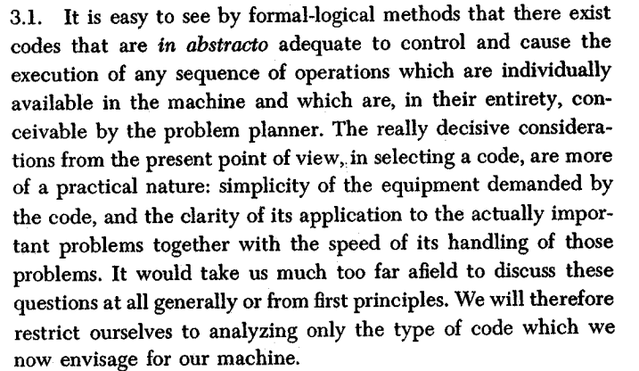
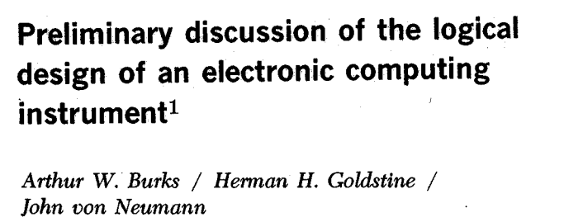
Operations of the Computer Hardware
Instruction set for a particular architecture (e.g. RISC-V) is represented by the Assembly language
Each line of assembly code represents one instruction for the computer
Instruction sets

Slide 5




Assembly Language
High Level Language Program (e.g., C)
temp = v[k] =
v[k+1]
v[k];
v[k+1];
= temp;
Compiler
Anything can be represented
as a number, i.e., data or instructions
lw | x3, | 0(x10)
lw | x4, | 4(x10)
sw | x4, | 0(x10)
sw | x3, | 4(x10)
Assembly Language Program (e.g., RISC-V)
lw | x3, | 0(x10)
lw | x4, | 4(x10)
sw | x4, | 0(x10)
sw | x3, | 4(x10)
Assembler
1000 1101 |  | 1110 | 0010 | 0000 0000 0000 0000
1000 | 1110 | 0001 | 0000 | 0000 | 0000 | 0000 | 0100
1010 | 1110 | 0001 | 0010 | 0000 | 0000 | 0000 | 0000
1010 | 1101 | 1110 | 0010 | 0000 | 0000 | 0000 | 0100
Machine Language Program (RISC-V)
Hardware Architecture Description (e.g., block diagrams)
+4
Reg[]
pc
pc+4
alu
alu ¹
pc
IMEM
^{wb} DataD
1
Reg[rs1]
0
ALU
DMEM
2
pc+4
0
inst[11:7] _{AddrD}
Branch Comp.
Reg[rs2]
Addr
DataR
1
wb
Architecture Implementation
inst[19:15] AddrA DataA inst[24:20] AddrB DataB
0
1
DataW
mem
0
Logic Circuit Description (Circuit Schematic Diagrams)
inst[31:7] _{Imm.}
Gen
imm [31:0]
A
B
Out = AB+CD
C
D

Slide 6
Assembly Language
Basic job of a CPU: execute lots of instructions.
Instructions are the primitive operations that the CPU may execute.
Like a sentence: operations (verbs) applied to operands (objects) processed in sequence …
Different CPUs implement different sets of instructions. The set of instructions implemented in a particular CPU is an Instruction Set Architecture (ISA).
Examples: ARM (cell phones), Intel x86 (i9, i7, i5, i3), IBM Power, IBM/Motorola PowerPC (old Macs), MIPS, RISC-V, ...

Slide 7
RISC-V Architecture
New open-source, license-free ISA spec
Supported by growing shared software ecosystem
Appropriate for all levels of computing system, from microcontrollers to supercomputers
32-bit, 64-bit, and 128-bit variants (we’re using 32-bit in class, textbook uses 64-bit)
Why RISC-V instead of Intel 80x86?
RISC-V is simple, elegant. Don’t want to get bogged down in gritty details.
RISC-V has exponential adoption

Slide 8
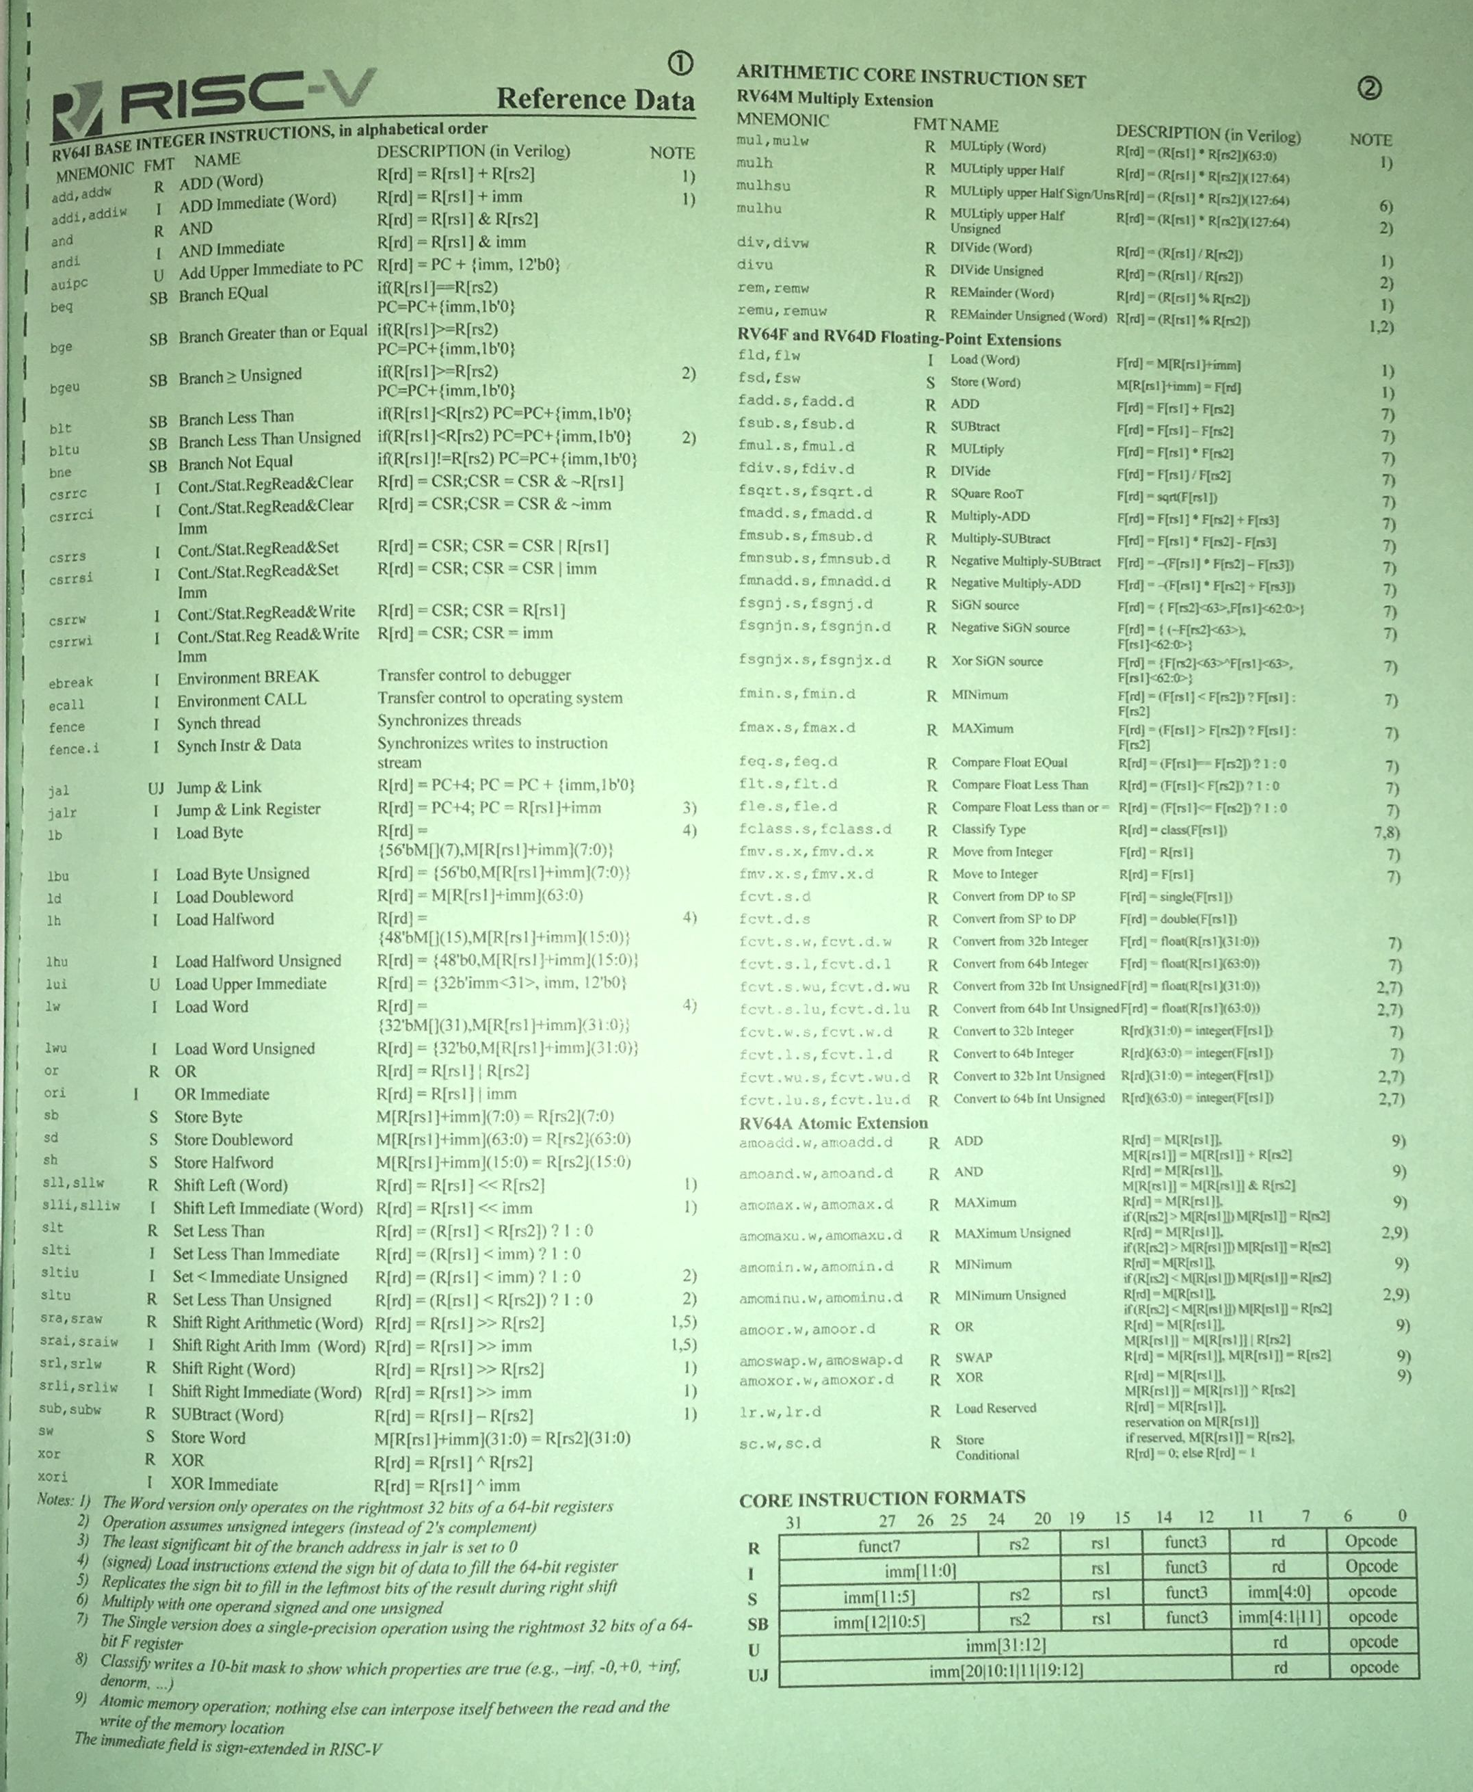
RISC V – GREEN CARD
https://www.cl.cam.ac.uk/teaching/1617/ECAD+Arch/files/docs/RISCVGreenCardv8-20151013.pdf
https://riscv.org/wp-content/uploads/2017/05/riscv-spec-v2.2.pdf
https://inst.eecs.berkeley.edu/~cs61c/resources/MIPS_Green_Sheet.pdf

Slide 9
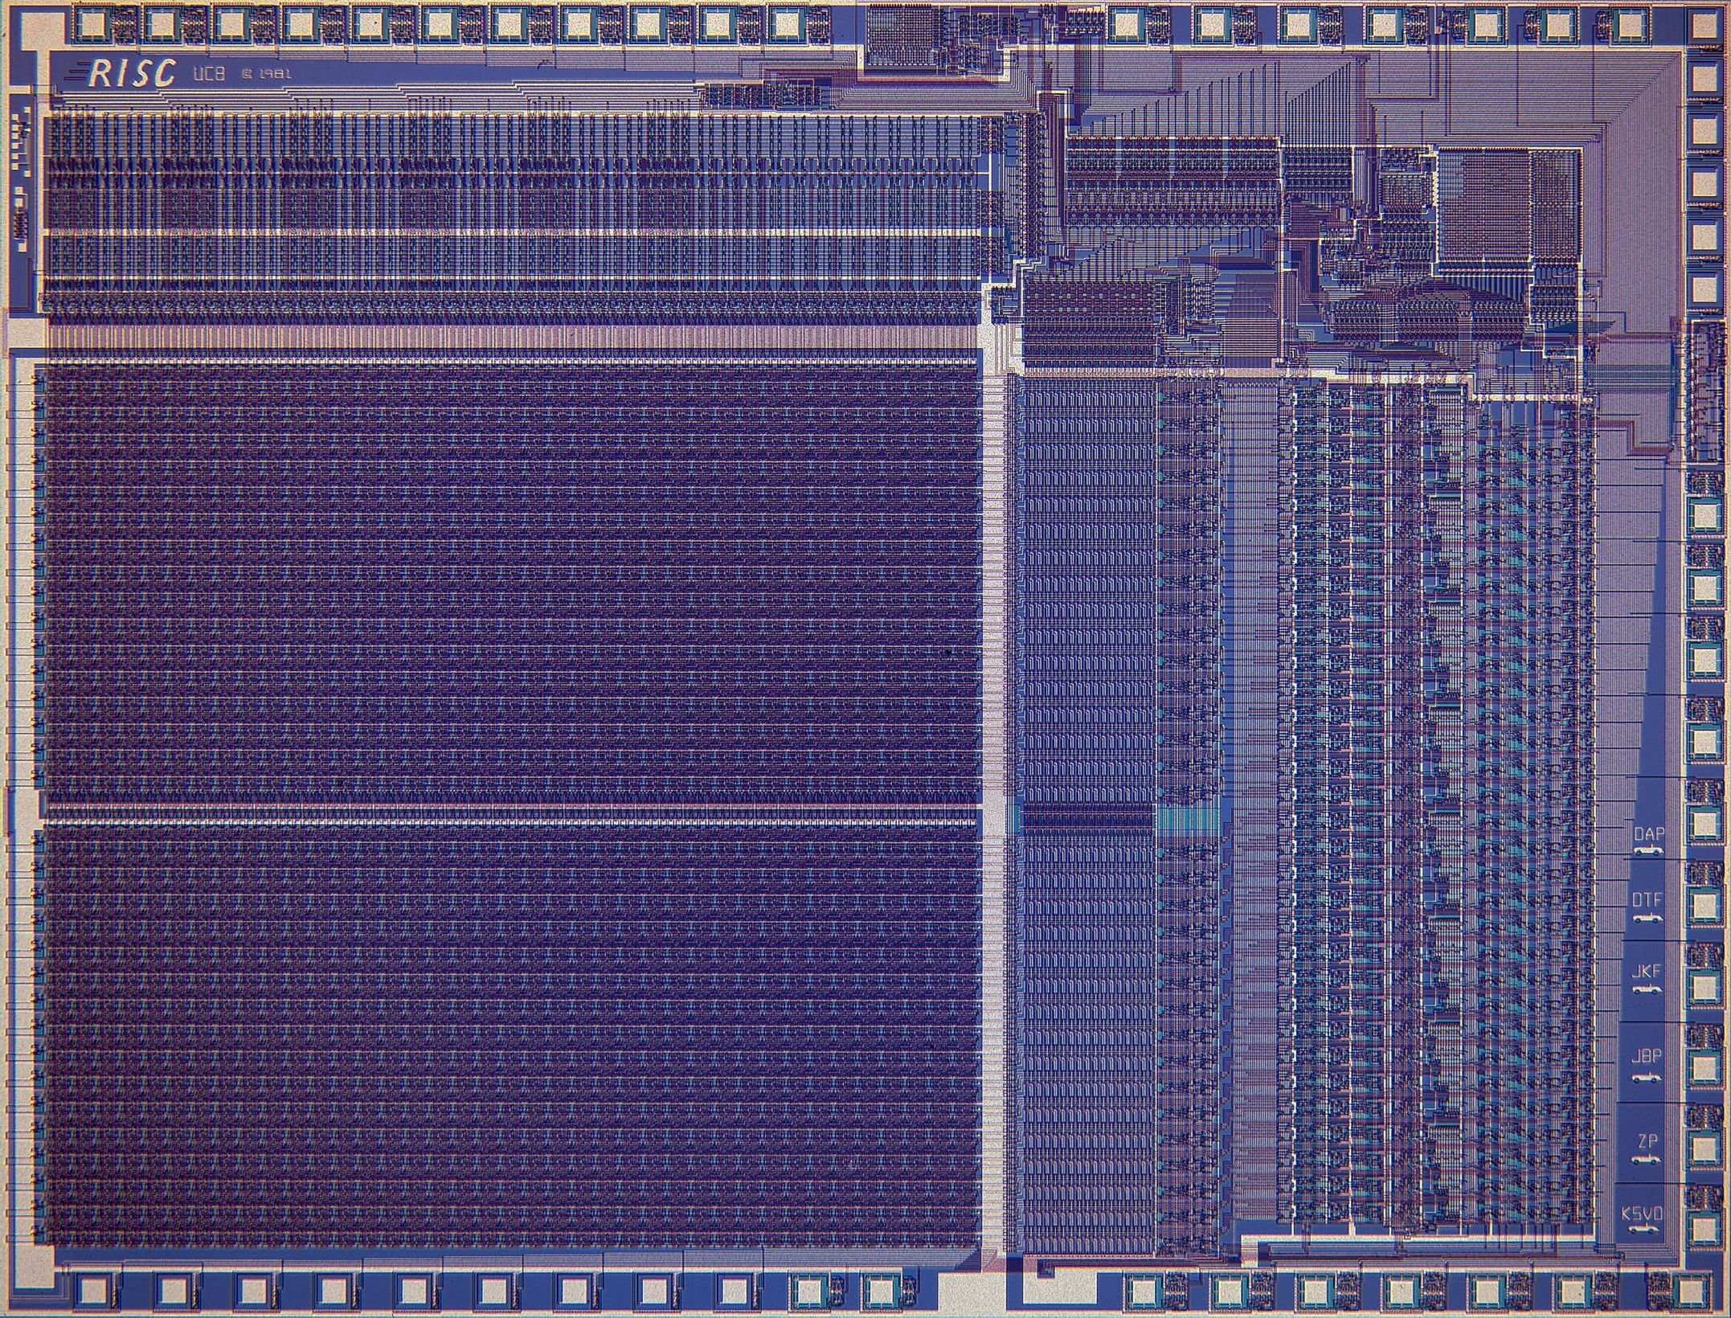
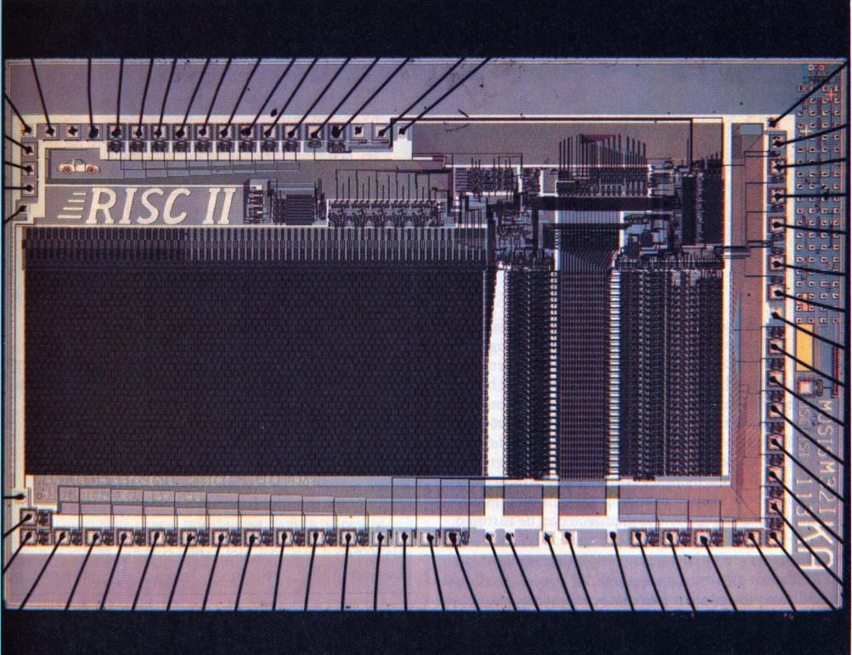
RISC V Origin https://cs61c.org/resources/
Started in Summer 2010 to support open research and teaching at UC Berkeley
Lineage can be traced to RISC-I/II projects (1980s)
As the project matured, it migrated to RISC-V foundation (www.riscv.org )
Many commercial and research projects based on RISC-V, open-source and proprietary
Widely used in education
Read more:
https://riscv.org/risc-v-history/
https://riscv.org/risc-v-genealogy/
RISC-I
RISC-II

Slide 10
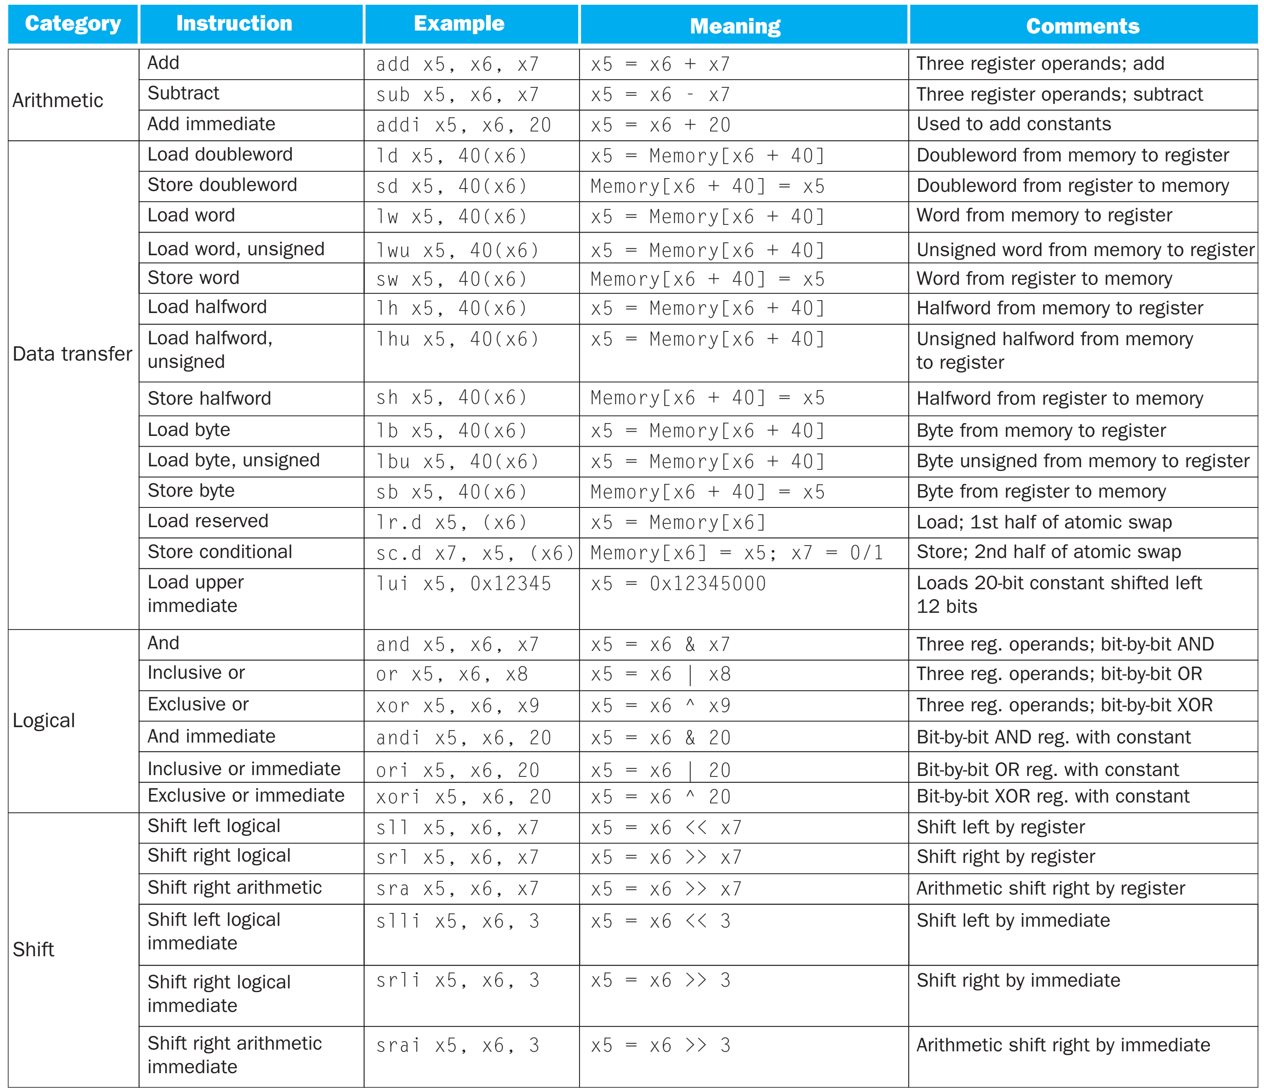
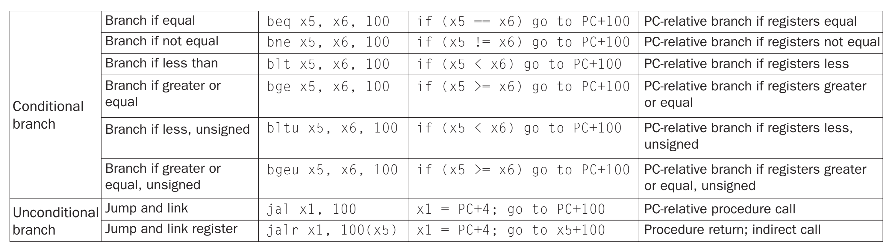
RISC V Instructions
Arithmetic : + , / , * , -
Logical: AND, OR, XOR
Data transfer: Load, store
Shift : >>, <<
Condition branch: if … then
Unconditional branch: jump to loop

Slide 11
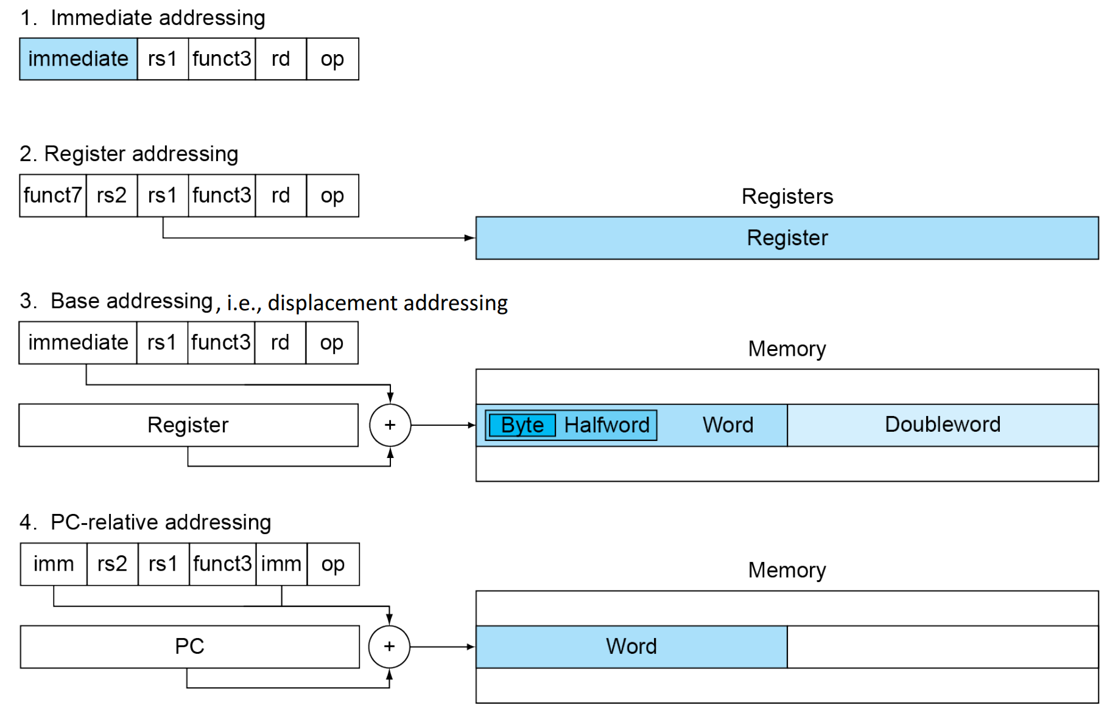
Operand of the Computer Hardware: RISC-V Addressing Summary
Constant or immediate operand
Register operand
Memory operand

Slide 12
Assembly Variables: Registers (1/3)
Elements of hardware: registers
Unlike HLL like C or Java, assembly cannot use variables
Why not? Keep Hardware Simple
Assembly operands are registers
Limited number of special locations built directly into the hardware
Operations can only be performed on these!
Benefit: Since registers are directly in hardware, they’re very fast (faster than 0.25ns)
Recall light is 3x10⁸m/s = 0.3m/ns = 30cm/ns = 10cm/0.3ns!!!… where 0.3ns is the clock period of a 3.33GHz computer

Slide 13

Aside: Registers are Inside the Processor
Processor
Memory
Input
Control
Enable? Read/Write
Datapath
Address
CPU
Extremely fast Extremely expensive
Tiny capacity
Program Counter (PC)
Processor chip
Bytes
Registers
Registers
Write Data
Read Data
Output
Arithmetic-Logic Unit (ALU)
Processor-Memory Interface
I/O-Memory Interfaces

Slide 14
Assembly Variables: Registers (2/3)
Drawback: Since registers are in hardware, there is a predetermined number of them
Solution: RISC-V code must be very carefully put together to efficiently use registers
32 registers in RISC-V. Why 32?
Smaller is faster, but too small is bad. Goldilocks principle (“This porridge is too hot; This porridge is too cold; this porridge is just right”)
Each RISC-V register is 32 bits wide (in RV32 variant)
Groups of 32 bits called a word in RV32
P&H textbook uses the 64-bit variant RV64

Slide 15
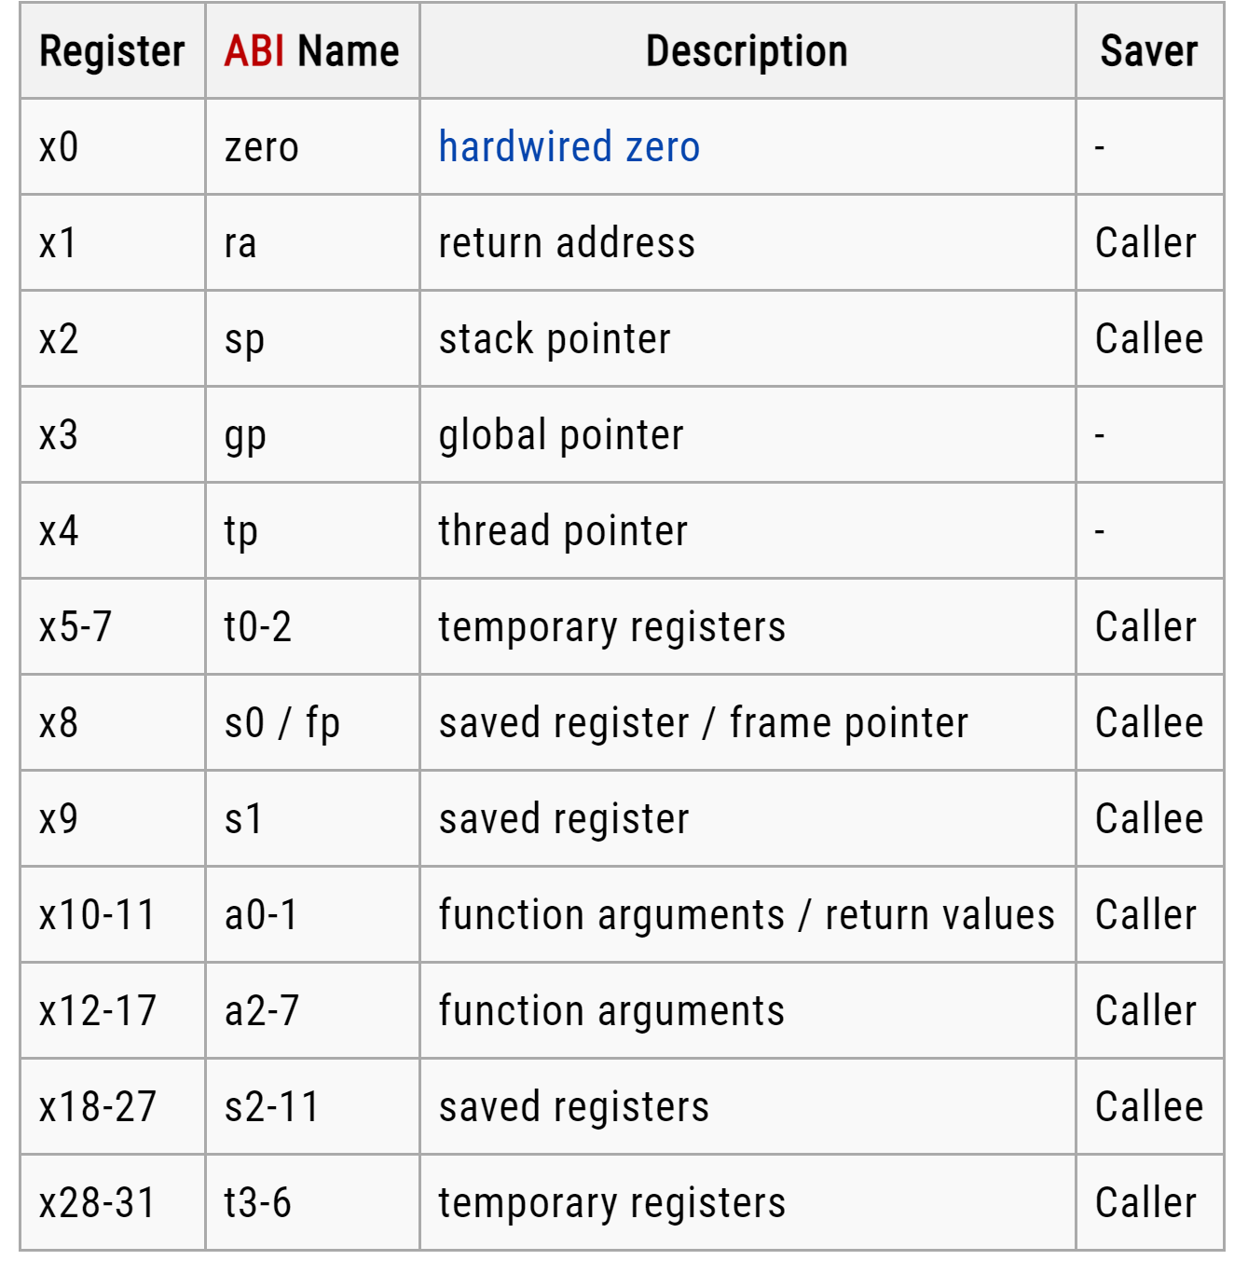
Assembly Variables: Registers (3/3)
Registers are numbered from 0 to 31
Referred to by number x0–x31
X0 is special, always holds value zero
So only 31 registers able to hold variable values
Each register can be referred to by number or name
Will add names later

Slide 16
C, Java variables vs. registers
In C (and most high-level languages) variables declared first and given a type. E.g.,
int fahr, celsius;
char a, b, c, d, e;
Each variable can ONLY represent a value of the type it was declared as (cannot mix and match int and char variables).
In assembly language, the registers have no type
Operation determines how register contents are treated

Slide 17
Comments in Assembly
Make your code more readable: comments!
Hash (#) is used for RISC-V comments anything from hash mark to end of line is a comment and will be ignored
This is just like the C99 //
Note: Different from C.
C comments have format /* comment */ so they can span many lines
In assembly language, each statement (called an Instruction), executes exactly one of a short list of simple commands
Unlike in C (and most other high-level languages), each line of assembly code contains at most 1 instruction
Instructions are related to operations (=, +, -, *, /) in C or Java

Slide 18
RISC-V Addition and Subtraction (1/4)
Syntax of Instructions:
one two, three, four
add x1, x2, x3
where:
one = operation by name
two = operand getting result (“destination,” x1)
three = 1st operand for operation (“source1,” x2)
four = 2nd operand for operation (“source2,” x3)
Syntax is rigid: 1 operator, 3 operands
Why? Keep hardware simple via regularity

Slide 19
Addition and Subtraction of Integers (2/4)
Addition in Assembly
Example: add x1,x2,x3 (in RISC-V)
Equivalent to: a = b + c (in C)
where C variables ⇔ RISC-V registers are: a ⇔ x1, b ⇔ x2, c ⇔ x3
Subtraction in Assembly
Example: sub x3,x4,x5 (in RISC-V)
Equivalent to: d = e - f (in C)
where C variables ⇔ RISC-V registers are:
d ⇔ x3, e ⇔ x4, f ⇔ x5

Slide 20
Addition and Subtraction of Integers (3/4)
How to do the following C statement?
a = b + c + d - e;
Break into multiple instructions
add x10, x1, x2 # a_temp = b + c
add x10, x10, x3 # a_temp = a_temp + d
sub x10, x10, x4 # a = a_temp - e
Notice: A single line of C may break up into several lines of RISC-V.
Notice: Everything after the hash mark on each line is ignored (comments).

Slide 21
Addition and Subtraction of Integers (4/4)
How do we do this?
f = (g + h) - (i + j);
Use intermediate temporary register
add x5, x20, x21 # a_temp = g + h
add x6, x22, x23 # b_temp = i + j
sub x19, x5, x6 # f = (g + h)- (i + j)

Slide 22
Immediates
There is no Subtract Immediate in RISC-V: Why? There are add and sub, but no addi counterpart
Limit types of operations that can be done to absolute minimum if an operation can be decomposed into a simpler
where RISC-V registers x3,x4 are associated with C variables f, g, respectively
addi x3,x4,-10 (in RISC-V)
f = g – 10 in C

Slide 23
Register Zero
One particular immediate, the number zero (0), appears very often in code.
So the register zero (x0) is ‘hard-wired’ to value 0; e.g.
add x3,x4,x0 # in RISC V
f = g # in C
where RISC-V registers x3,x4 are associated with C variables f, g
Defined in hardware, so an instruction
add x0,x3,x4 # will not do anything!

Slide 24


Data Transfer: Load from and Store to memory
Processor Control | Enable? Read/Write
Datapath Program Counter (PC) Arithmetic-Logic Unit (ALU) | Address
 | Write Data
 | = Store to Memory Read Data = Load from Memory
Memory
Input
Program
Registers
Bytes
Much larger place to hold values, but slower than registers!
Data
Output
Very fast,
but limited space to hold values!
RISC-V (32)

Slide 25
Memory Addresses are in Bytes
Data typically smaller than 32 bits, but rarely smaller than 8 bits (e.g., char type)–works fine if everything is a multiple of 8 bits
8 bit chunk is called a byte (1 word = 4 bytes)
Memory addresses are really in bytes, not words
Word addresses are 4 bytes apart
Word address is same as address of rightmost byte – least-significant byte (i.e. Little-endian convention)
3
2
1
0
31
0
15 | 14 | 13 | 12
11 | 10 | 9 | 8
7 | 6 | 5 | 4
3 | 2 | 1 | 0
Least-significant byte in a word
31 24 23 16 15 8 7 0
Least-significant byte gets the smallest address
Notes:
In computing, endianness is the order or sequence of bytes of a word of digital data in computer memory. Endianness is primarily expressed as big-endian (BE) or little-endian (LE). A big-endian system stores the most significant byte of a word at the smallest memory address and the least significant byte at the largest. A little-endian system, in contrast, stores the least-significant byte at the smallest address.

Slide 26
Homework_ week 2
Exercise 2.1 – 2.11 (pg. 162 -164 in P&H textbook)

Slide 27
Big Endian vs. Little Endian
The adjective endian has its origin in the writings of 18th century writer Jonathan Swift. In the 1726 novel Gulliver's Travels, he portrays the conflict between sects of Lilliputians divided into those breaking the shell of a boiled egg from the big end or from the little end. He called them the "Big-Endians" and the "Little-Endians".
The order in which BYTES are stored in memory
Bits always stored as usual (E.g., 0xC2=0b 1100 0010)
Consider the number 1025 as we typically write it:
BYTE3 BYTE2 BYTE1 BYTE0
00000000 00000000 00000100 00000001
Big Endian
Little Endian
ADDR3 ADDR2 ADDR1 ADDR0
ADDR3 | ADDR2 | ADDR1 | ADDR0
BYTE0 | BYTE1 | BYTE2 | BYTE3
10000000 00000100 00000000 00000000
Examples
Names in China or Hungary (e.g., Nikolić Bora) Java Packages: (e.g., org.mypackage.HelloWorld) Dates in ISO 8601 YYYY-MM-DD (e.g., 2020-09-07)
Eating Pizza crust first
BYTE3 BYTE2 BYTE1 BYTE0
00000000 00000000 00000100 00000001
Examples
Names in the US (e.g., Bora Nikolić)
Internet names (e.g., cs.berkeley.edu)
Dates written in Europe DD/MM/YYYY (e.g., 07/09/2020) Eating Pizza skinny part first

Slide 28
Speed of Registers vs. Memory
Processor chip
Extremely fast Extremely expensive
Tiny capacity
Core
Registers
Fast Priced reasonably Medium capacity
DRAM chip
e.g. DDR3/4/5 HBM/HBM2/3
Physical Memor y
Random -Access Memo ry (RAM)
Registers: 32 words (128 Bytes)
Memory (DRAM): Billions of bytes (2 GB to 64 GB on laptop) and physics dictates that Smaller is Faster
How much faster are registers than DRAM??
About 50-500 times faster! (in terms of latency of one access - tens of ns)
But subsequent words come every few ns
Garcia, Nikolić

Slide 29
Load from Memory to Register
C code
int A[100]; g = h + A[3];
Using Load Word (lw) in RISC-V:
lw x10,12(x15) # Reg x10 gets A[3]
add x11,x12,x10 # g = h + A[3]
# x15 – base register (pointer to A[0]) 12 – offset in bytes
# Offset must be a constant known at assembly time
Data flow
Garcia, Nikolić
40

Slide 30
Store from Register to Memory
C code
int A[100]; A[10] = h + A[3];
Using Store Word (sw) in RISC-V:
lw x10,12(x15) # Temp reg x10 gets A[3]
add x10,x12,x10 # Temp reg x10 gets h + A[3]
sw x10,40(x15) # A[10] = h + A[3]
Note:
x15 – base register (pointer) 12,40 – offsets in bytes
x15+12 and x15+40 must be multiples of 4
Data flow
Garcia, Nikolić
41

Slide 31
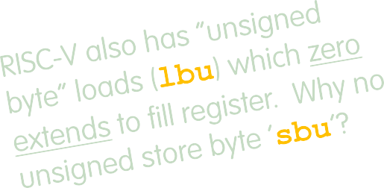
Loading and Storing Bytes
In addition to word data transfers (lw, sw), RISC-V has byte data transfers:
load byte: lb
store byte: sb
Same format as lw, sw. E.g.,
lb x10,3(x11)
-> contents of memory location with address = sum of “3” + contents of register x11 is copied to the low byte position of register x10.
x10:
xxxx xxxx xxxx xxxx xxxx xxxx xzzz zzzz
byte
loaded
Garcia, Nikolić
…is copied to “sign-extend”
This bit
RISC-V (42)

Slide 32




Example: What is in x12 ?
addi x11,x0,0x3F5 sw x11,0(x5)
lb x12,1(x5)
Memory
x5
x11 x12
Garcia, Nikolić

Slide 33
Substituting addi
The following two instructions:
lw x10,12(x15) # Temp reg x10 gets A[3]
add x12,x12,x10 # reg x12 = reg x12 + A[3]
Replace addi:
addi x12, value # value in A[3]
But involve a load from memory!
Add immediate is so common that it deserves its own instruction!

Slide 34
RV32 So Far…
Addition/subtraction
add rd, rs1, rs2 sub rd, rs1, rs2
Add immediate
addi rd, rs1, imm
Load/store
lw rd, rs1, imm
lb rd,rs1, imm
lbu rd,rs1, imm
sw rs1, rs2, imm
sb rs1, rs2, imm

Slide 35
Computer Decision Making
Based on computation, do something different
In programming languages: if-statement
RISC-V: if-statement instruction is
beq reg1,reg2,L1
means: go to statement labeled L1 if (value in reg1) == (value in reg2) ….otherwise, go to next statement
beq stands for branch if equal
Other instruction: bne for branch if not equal

Slide 36
Types of Branches
Branch – change of control flow
Conditional Branch – change control flow depending on outcome of comparison
branch if equal (beq) or branch if not equal (bne)
Also branch if less than (blt) and branch if greater than or equal (bge)
And unsigned versions (bltu, bgeu)
Unconditional Branch – always branch
a RISC-V instruction for this: jump (j), as in
j label

Slide 37
Example if Statement
Assuming translations below, compile if block
f → x10
i → x13
g → x11 h → x12
j → x14
if (i == j) f = g + h;
bne x13,x14,Exit add x10,x11,x12
Exit:
May need to negate branch condition

Slide 38
Example if-else Statement
Assuming translations below, compile
f → x10
i → x13
g → x11 h → x12
j → x14
bne x13,x14,Else
add x10,x11,x12
j Exit
Else:sub x10,x11,x12
Exit:
if (i == j) f = g + h;
Else
f = g – h;

Slide 39
Magnitude Compares in RISC-V
General programs need to test < and > as well.
RISC-V magnitude-compare branches:
“Branch on Less Than”
Syntax: blt reg1,reg2, Label
Meaning: if (reg1 < reg2) goto Label;
“Branch on Less Than Unsigned”
Syntax: bltu reg1,reg2, Label
Meaning: if (reg1 < reg2)// treat registers
as unsigned integers
goto label;
Also “Branch on Greater or Equal” bge and bgeu
Note: No ‘bgt’ or ‘ble’ instructions
Garcia, Nikolić
51

Slide 40
Loops in C/Assembly
There are three types of loops in C:
while
do … while
for
Each can be rewritten as either of the other two, so the same branching method can be applied to these loops as well.
Key concept: Though there are multiple ways of writing a loop in RISC-V, the key to decision- making is conditional branch
Garcia, Nikolić

Slide 41
C Loop Mapped to RISC-V Assembly
int A[20];
int sum = 0;
for (int i=0; i < 20; i++)
sum += A[i];
Assume that the base address of A, sum and i correspond to registers x9,x10 and x11
add x9, x8, x0 # x9=&A[0]
add | x10, x0, | x0 | # | sum
add | x11, x0, | x0 | # | i
addi x13,x0, 20 # x13 Loop:
bge x11,x13,Done
lw x12, 0(x9) # x12 A[i]
add x10,x10,x12 | # | sum+=
addi x9, x9,4 | # | &A[i+1]
addi x11,x11,1 | # | i++
j Loop
Done:

Slide 42
C Loop Mapped to RISC-V Assembly
Here is a traditional loop in C: while (save[i] == k) i += 1; Assume that i and k correspond to registers x22 and x24 and the base of the array save is in x25. What is the RISC-V assembly code corresponding to this C code?

